Slide 1

Database design
Lecturer
Rokas Slaboševičius
Data

Slide 2
Data types
Database design
When creating a table, you need to list its columns, for each of which you need to specify a set of possible values - the column type.
In particular, the data type of the column is assigned to the data type:
Symbolic data (text);
Binary data;
Numbers;
Dates;
Time;

Slide 3
Character data types
Database design
The character string has a character count attribute (n) which indicates the length of the character string.
Fixed-length character strings:
CHAR(n) - up to 254B
Variable length:
VARCHAR(n) - up to 32672 (4000) bytes long,

Slide 4
Numeric data (number data types)
Database design
SMALLINT - integers [-32768 - 32767];
INTEGER - "large" integers (4b) [-2147483648 - 2147483647];
BIGINT - "extra large" integers (8b) [-9223372036854775808 - 9223372036854775807];
REAL - floating-point numbers (32b);
FLOAT (DOUBLE) - double precision numbers (64b);
DECIMAL (n, m) (NUMERIC) - a number of variable precision and size (n and m refer to the number of digits to the decimal point and the number of digits after the decimal point);

Slide 5
Date and time data
Database design
DATE - (4B)
TIME - (3B)
TIMESTAMP - (10B)
DATE and TIME display depends on the locale,2005.01.01, 12:00:00,2005-01-01-12.15.55.330000
DBMS always "understands" ISO date and time:2005-01-01, 12:00:00

Slide 6
Data types
Database design
All SQL data types have a special value - NULL.
Once the data type has been selected for a column, the length characteristic and accuracy must also be selected.

Slide 7
Data types
Database design
CREATE TABLE
When creating (defining) a table, be sure to specify:
the name of the table;
table column names and column types;

Slide 8
Create table syntax
Database design
CREATE TABLE Executors (
Id INTEGER NOT NULL,
LastName CHAR(30) NOT NULL,
Qualification CHAR(16) DEFAULT Informatics,
Category SMALLINT,
Education CHAR(10));
NOT NULL - the column cannot contain NULL values.
DEFAULT - default value if nothing is filled in

Slide 9
Create table syntax
Database design
CREATE TABLE Projects (
Id INTEGER NOT NULL,
Name VARCHAR(254) NOT NULL,
Importance CHAR (10) DEFAULT Medium,
Start DATE,
Duration SMALLINT);
CREATE TABLE Execution (
Project INTEGER NOT NULL,
Executor INTEGER NOT NULL,
Status VARCHAR(32) DEFAULT Programmer,
Hours SMALLINT);

Slide 10
Alter table syntax
Database design
Most of the properties of the table can be specified later:
ALTER TABLE Executors ADD Birthday DATE;
ALTER TABLE Executors DROP Birthday;
ALTER TABLE Projects ALTER Importance DROP DEFAULT;
ALTER TABLE Projects ALTER Importance SET DEFAULT 'Large';

Slide 11
Primary key
Database design
CREATE TABLE TEST(
ID INT PRIMARY KEY, -- primary key
NAME VARCHAR(255));
CREATE TABLE TEST(
ID INT, -- without primary key
NAME VARCHAR(255));

Slide 12
Primary key
Database design
CREATE TABLE People(
P_Id INT NOT NULL PRIMARY KEY,
LastName VARCHAR(255) NOT NULL,
FirstName VARCHAR(255),
Address VARCHAR(255),
City VARCHAR(255));

Slide 13
Primary key
Database design
CREATE TABLE Persons (
P_Id INT NOT NULL,
LastName VARCHAR(255) NOT NULL,
FirstName VARCHAR(255),
Address VARCHAR(255),
City VARCHAR(255),
-- combined multi-column primary key CONSTRAINT pk_PersonID PRIMARY KEY P_Id, LastName)
);

Slide 14
Primary key
Database design
The primary key can be added and deleted after the table is created using ALTER TABLE syntax:
ALTER TABLE Persons ADD PRIMARY KEY (P_Id);
ALTER TABLE Persons ADD CONSTRAINT pk_PersonID PRIMARY KEY (P_Id, LastName);
ALTER TABLE Persons DROP CONSTRAINT pk_PersonID

Slide 15
Foreign key
Database design
-- external key added when the table is created
CREATE TABLE Orders (
O_Id INT NOT NULL PRIMARY KEY,
OrderNo INT NOT NULL,
P_Id INT FOREIGN KEY REFERENCES Persons (P_Id));
-- external key added after table creation
ALTER TABLE Orders ADD FOREIGN KEY (P_Id)REFERENCES Persons(P_Id);

Slide 16
Foreign key
Database design
CREATE TABLE Orders (
O_Id INT NOT NULL,
OrderNo INT NOT NULL,
P_Id INT,
PRIMARY KEY (O_Id),
CONSTRAINT fk_PerOrders FOREIGN KEY (P_Id)REFERENCES Persons(P_Id));

Slide 17
Foreign key
Database design
ALTER TABLE Orders ADD CONSTRAINT fk_PerOrders
FOREIGN KEY (P_Id) REFERENCES Persons(P_Id);
ALTER TABLE Persons DROP CONSTRAINT fk_PersonID;

Slide 18
Indexes
Database design
An index is a database object that can speed up access to data by presenting the user with rows from a table. Indexes can be created automatically or externally. If an index is not assigned to a column, the table will be fully searchable across the entire table.
The index provides direct and quick access to rows in tables. Their purpose is to eliminate disk I/O operations. Once the indexes have been created, no direct user action is required to access them.

Slide 19
Indexes
Database design
Indexes are logically and physically independent of the table for which they are created. This means that they can be created or deleted at any time and do not affect the underlying table itself or other indexes. When a table is deleted, the indexes bound to it are also deleted. Indexes are thus created automatically or manually. They are created automatically when the primary key is set or the column values are defined as unique. Manually, an index can be created on non-unique column values in order to speed up access to table rows.

Slide 20
Indexes
Database design
An index can be created for one or several columns.CREATE INDEX Index ON Table (Column1[,Column2]...);
We can create an index for the Ename field in the EMP table:
CREATE INDEX Emp_Ename_index ON EMP(Ename);
DROP INDEX Emp_Ename_index;

Slide 21
Indexes
Database design
Having many indexes created for a table does not mean that it will speed up work on the DB itself.The more indexes linked to a table, the more work the server has to do to update the indexes after each operation.

Slide 22
Indexes
Database design
Indices are created when:
columns are often used in a WHERE clause or a combining clause
The column holds a wide range of values;
the column holds a large number of NULL values;
two or more columns are often used together in a WHERE paragraph or a combining clause;
the table is large and most queries contain 2-4% of the total rows that exist in the table;

Slide 23
DB design
Database design
It is carried out before the DB generation process starts;
It is essential for an efficient, accurate and responsive system;
It is advisable to start the planning process in writing on a piece of white paper;
While this design may seem like a waste of time at the outset, in reality more time is wasted in later DB corrections if no planning was done beforehand;

Slide 24
DB design
Database design
Define the purpose of the database;
Define which tables will be needed;
Define which fields will be required in the DB tables;
Specify fields with unique values;
Determine how the tables will relate to each other;
Improve the original draft

Slide 25
DB design
Database design
There are three main questions to answer when starting to build a database:
What data should the database hold?
What information will the DB user want to know about this data?
What will the user want to do with the data?

Slide 26
DB design
Database design
The library database is being developed.
The database should contain data on readers and books;
A DB user will want to know what books are being read, when they are due for return, how many books by which author are in the library, and so on;
The user will want to retrieve information from the DB, as well as modify it in the event of changes in the situation (returned or borrowed books), new readers, new publications, deletion of records of withdrawn books, etc;

Slide 27
DB design
Database design
The granularity of the description of the purpose of the DB depends on the situation:
A few sentences describing the key points;
A formal document with detailed descriptions of each use;

Slide 28
DB design
Database design
Which data will be stored?
The aim is to have all the information about an object in the same table, with each table dedicated to one object only - this is not always successful
Which data will be collected?

Slide 29
DB design
Database design
The library's DB will hold information on readers, authors, books and who has borrowed which book
4 Tables:
Readers
Authors
Books
Lease agreements

Slide 30
DB design
Database design
Once you have decided which tables will hold the data, you need to decide what information will be collected for each object;
It must be exactly as much as is needed, neither too much nor too little

Slide 31
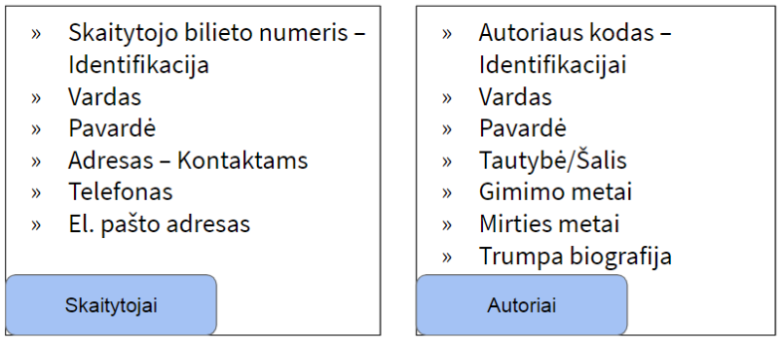
DB design
Database design

Slide 32
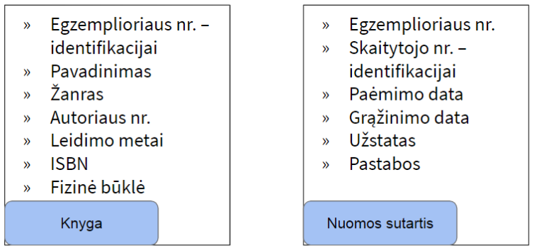
DB design
Database design

Slide 33
DB design
Database design
The following principles should be followed when creating DB tables and fields:
Each piece of information is stored in only one table;
The table should not contain duplicate information;
Each table should contain information on only one object;
The same information should not be repeated in several tables;

Slide 34
Primary keys
Database design
Each table must have its own primary key - a field whose value is unique for each record.
The primary key may be:
Single field
Automatically ascending (1, 2, 3... a, b, c) or user-defined (ID number, ISBN, student ID, etc.);
○Multi-field
Unique - not a specific field value, but a set of several field values (first name AND last name, reader no. AND copy no.)

Slide 35
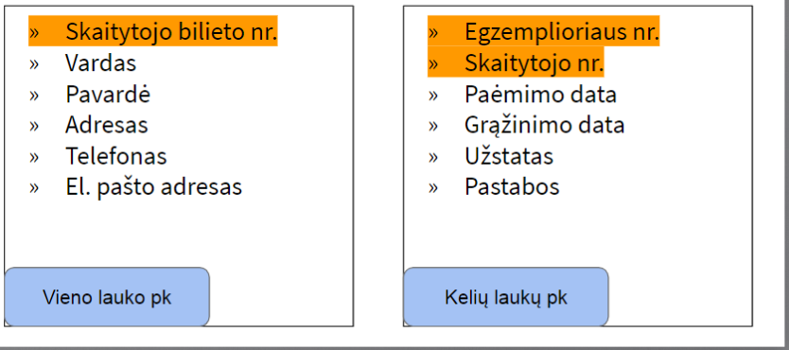
Primary keys
Database design

Slide 36
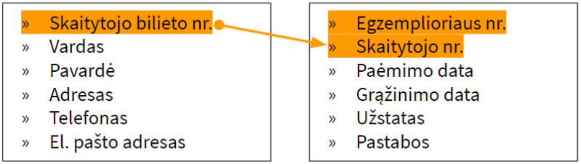
External keys
Database design
Primary keys are also important for creating relationships between tables. A primary field in one table is inserted into another table and becomes a foreign key there.

Slide 37
DB normalisation
Database design
Checking that:
- Table 2.1 contains only data related to the primary key
- that each field contains only one data block
- that duplicate data is eliminated
In normalisation, data is assigned to its logical and unique location

Slide 38
DB normalisation
Database design
Objectives of standardisation:
Sorting data into logical groups such that each group describes part of the whole;
Minimising the amount of duplicate data in the database;
Creating an efficiently and quickly accessible and manageable database without compromising data integrity;
Creating a structure so that when data changes are made, they only need to be corrected in one place.

Slide 39
DB normalisation
Database design
Normal shape:
Non-normalised data
Duplicate groups, uneven data, insertion and deletion anomalies;
Normal form 1: Each db field stores only one value and there are no duplicate groups in the table;
Normal Form 2: Meets the requirements of Form 1 and the information that is not directly dependent on the primary key must be transferred to the next table;
3 normal form :Meets the requirements of form 2 and all fields whose values can be extracted from the data of other fields in the table must be removed;

Slide 40
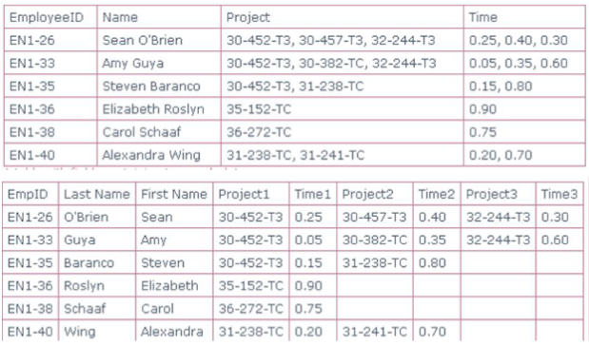
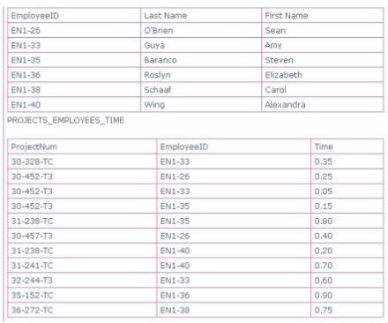
1 normal form
Database design

Slide 41
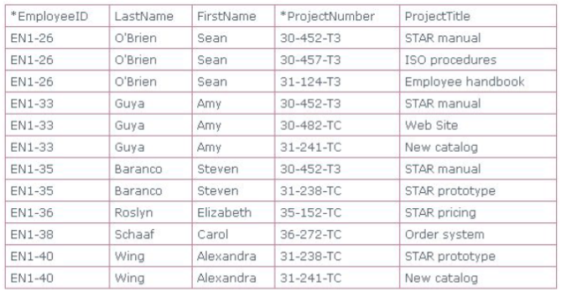
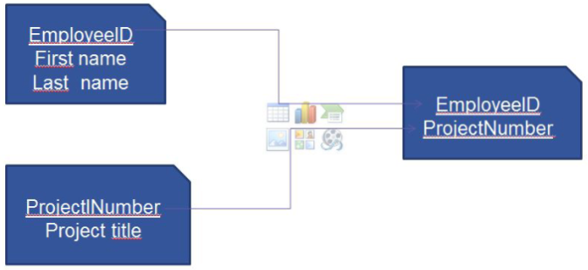
2 normal form
Database design

Slide 42
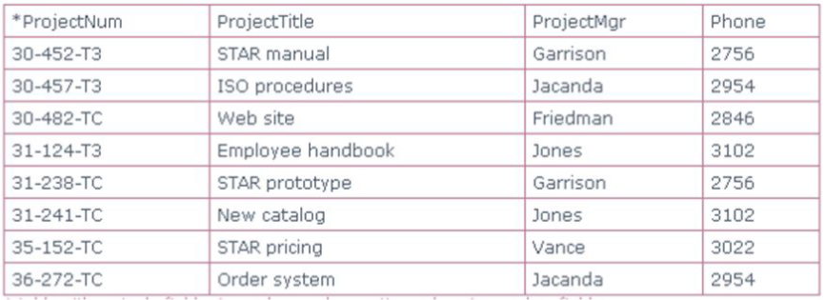

3 normal form
Database design

Slide 43
Relationships between tables
Database design
Relationship - a link between common fields in two database tables.
Three types:
1 : 1 Rarely used, usually for security reasons, or when some of the fields in the table are usually empty;
1 : ∞ The most commonly used link. Primary key with foreign key field in the following table
∞ : ∞ To be split into two 1 : ∞ relations via an intermediate table

Slide 44
Improvement
Database design
Once the initial DB project (tables, fields and relationships) has been put together, it should be carefully examined for possible flaws.
Check that this database structure will allow you to get the answers you want.
Last chance to easily correct DB structure errors

Slide 45
Common mistakes
Database design
Too little attention to planning
Ignoring normalisation
Poorly chosen field/table headings
Lack of documentation

Slide 46

Database design
Task 1
The Bank of Lithuania asks you to make a DB for them. They want the DB to contain data on all people in Lithuania (their personal identification number, name, surname, phone number) so that they can find out which banks they have accounts with and how much money they have in them.
Draw a structural diagram of the database;
Label the relationships, indicating their type (1 : 1 1 : ∞ ∞ : ∞);
Mark the primary keys of the tables;
The DB must contain:
More than 2 tables;
At least 5 entries (rows) per table;
Please list the account numbers and names of the banks where Antanas (the name of the person you have inserted may be different) has a balance of more than 1000.
SELECT Account.Number, Bank.Name, Person.FirstName FROM Account JOIN Bank ON Account.BankID = Bank.ID JOIN Person ON Account.PersonalID = Person.ID WHERE Person.FirstName = 'Antanas' AND Account.Balance > 1000;

Slide 47
Lecture title
Headline
www.youtube.com
Useful information

